Slide 1
Your first 3D Python program
DAY 03 OF 16 · 3D & 6DOF STREAMING
Import, extract, analyse, visualise, export: the four-step program from the book, run on a real file.
Environment
Import
Attributes
Analysis
Visualise & export
Book: Ch. 3 · Code: day03_first_3d_program/
Notes:
Today is practical. The structure follows the book’s Chapter 3 section ‘Creating a 3D Python Program’: importing 3D data, extracting attributes, attribute-based analysis, visualisation and export. Every student should leave with a working environment and a script they understand line by line.

Slide 2

Every 3D program follows the same four steps
BOOK CH. 3
01
02
03
04
Import
Extract
Analyse
Visualise & export
Read a file into a NumPy array (rows = points).
Slice columns: xyz, rgb, labels.
Statistics, filters, per-class summaries.
Open3D window, then .ply for other tools.
Our file has 7 columns: X;Y;Z;R;G;B;class, the same layout as the book’s ASCII examples.
Day 03 · First 3D program
2
Notes:
Present the pipeline as a recipe they will reuse all semester. The book uses NumPy loadtxt on an ASCII file with a header and a delimiter, then slices columns. Our script does the same on a generated file, street_scene.txt, whose columns are X;Y;Z;R;G;B;class. Emphasise that a point cloud in Python is just a 2D array: one row per point, one column per attribute. Ask: what shape is an array of 60,000 points with 7 attributes? (60000, 7).

Slide 3
A clean environment saves hours
BOOK CH. 3 · SETUP
Python 3.10–3.12
Base libraries
3D libraries
Open3D publishes wheels for these versions. Use a virtual environment per project.
NumPy for arrays, SciPy for k-d trees, Matplotlib for plots, Pillow for images.
Open3D for processing and viewing. Optional: laspy (LiDAR), PyVista, DracoPy.
01
02
03
Day 03 · First 3D program
3
Notes:
Go through requirements.txt and check_setup.py together. The book recommends a dedicated environment (it uses Anaconda); a standard venv also works. Common problems: wrong Python version for Open3D, no OpenGL on a remote machine, Windows path issues. Tell students that the Open3D window is optional in our scripts: everything also writes PNG previews to outputs, so headless servers work. 5 minutes.

Slide 4
What each column means
STEP 2 · ATTRIBUTES
Column | Type | Meaning | Typical use
X, Y, Z | float (m) | Position in the world frame | Geometry, distances, rendering
R, G, B | 0–255 | Colour seen by the sensor | Display, texture, segmentation
class | integer | Label: 0 ground, 1 wall, 2 roof… | Semantics, training, smart streaming
(intensity) | float | LiDAR return strength | Material, road markings
(normal) | 3 floats | Surface direction | Lighting, meshing, features
Day 03 · First 3D program
4
Notes:
The first three rows are in our file; the last two are common in real data and appear later (normals on Day 8). Note that labels give us semantics for free in this synthetic dataset, which lets us evaluate algorithms on Day 9. Ask: which attribute would you use to find road markings in a LiDAR scan? Intensity, because paint reflects differently than asphalt.

Slide 5
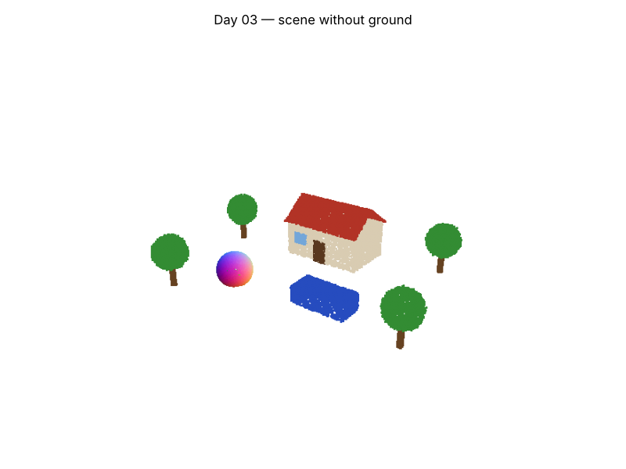
Filters turn questions into masks
STEP 3 · ANALYSIS
■ above = xyz[:, 2] > 0.3
■ keeps 59% of points: everything that is not ground
■ Per class: count, mean height, extent
■ One line of NumPy = one spatial question
outputs/no_ground.png: the mask z > 0.3 m removes the ground in one line of NumPy.
Day 03 · First 3D program
5
Notes:
Explain boolean masks: xyz[:, 2] > 0.3 gives True or False per point, and indexing with it keeps only the True rows. The script prints statistics per class: point counts, mean height per class (roof about 3.8 m, ground about 0 m). This attribute-based analysis is exactly the book’s third step. Ask the class to guess the height threshold that removes the ground but keeps the car, then check in the lab.

Slide 6
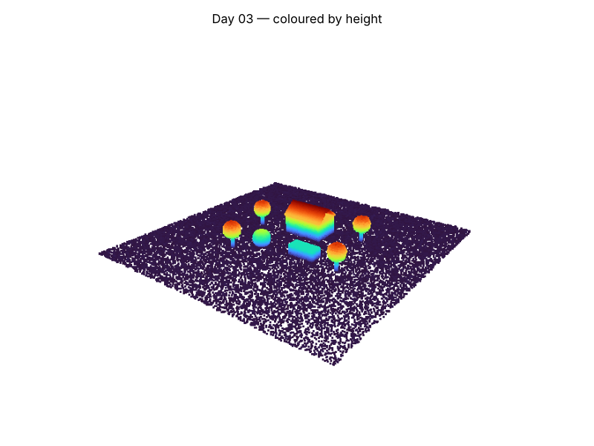
Colour by an attribute to see it
STEP 4 · VISUALISE & EXPORT
■ Open3D window: rotate, zoom, pan
■ write_ply → scene_full.ply, scene_no_ground.ply
■ Same files open in MeshLab / CloudCompare
Export to .ply and open the file anywhere: MeshLab, CloudCompare, or 3dviewer.net in a browser.
Day 03 · First 3D program
6
Notes:
Colouring by an attribute is the fastest way to check it: here a colour ramp maps height from blue (low) to red (high). The script exports three PLY files. Show one opened in a free tool; CloudCompare is the standard open-source desktop tool for point clouds and is mentioned in the book’s software chapter. Ask: why export at all if Python can show it? Because other people and other tools (and our streaming server later) need a standard file.

Slide 7
Your first 3D program end to end
HANDS-ON LAB · COPY, RUN, LOOK
RUN IT
cd day03_first_3d_program
python first_program.py
# then: change the threshold,
# export only the roof (class 2)
→ Read the per-class table in the terminal.
→ Open outputs/*.ply in a viewer.
→ Try the three exercises in the README.
Day 03 · First 3D program
7
Notes:
Students run, read, then modify. Insist that they open first_program.py and read it; it is about 60 lines and commented in the order of the 4 steps. Exercises: change the height threshold, export only the roof, swap in one of the book’s datasets by changing delimiter and column indices. 35 minutes.

Slide 8
Three things to remember
1
A point cloud in Python is an (N, k) array: rows are points, columns are attributes.
2
Import → extract → analyse → visualise/export is the skeleton of every 3D script.
3
Masks on attributes answer spatial questions in one line.
BEFORE NEXT SESSION
Start Lab L2, questions 1 and 2. Next time we look at what all those bytes cost.
Day 03 · First 3D program
8
Notes:
Recap the four steps. Preview Day 4: the same scene in five file formats, and why bytes per point is the number that decides whether a 3D stream fits through a network.

